Slide 1
NextRoom
Nicolò Palmiero
Luigi Sigillo
Supervisor: Joy Abi Rizk
Repository
https://github.com/LuigiSigillo/NextRoom
Notes:
Hi Im luigi sigillo and today with nicolo palmiero we will present our big project for the iot 2020 class called nextroom.

Slide 2
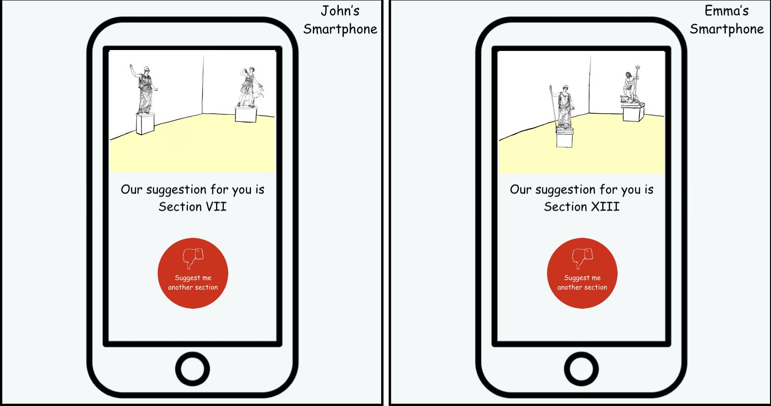
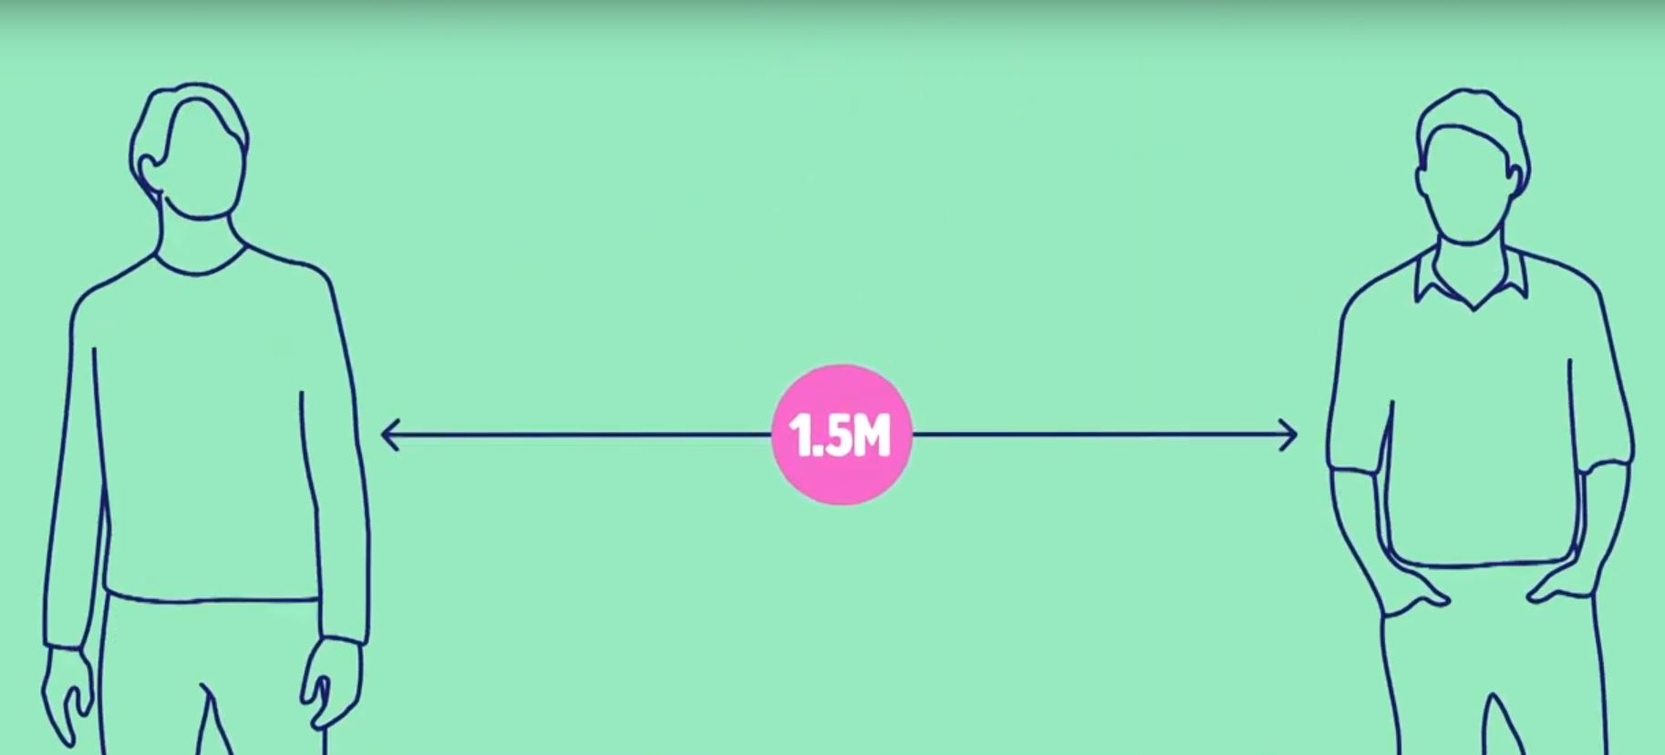
The problems
Personalized tours in the museum
Museum visits during the COVID-19 emergency
Notes:
Personalized tour: avoid that people not enjoy the visit and walk away from section bored and not happy about what they have seen.
COVID 19 crowd and security distance.

Slide 3

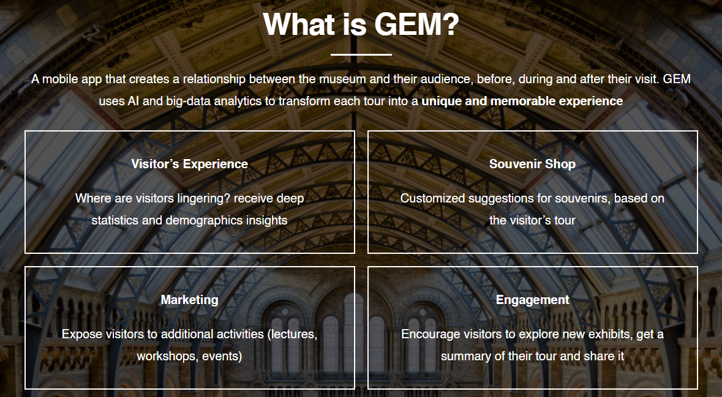
Existing approaches

Slide 4
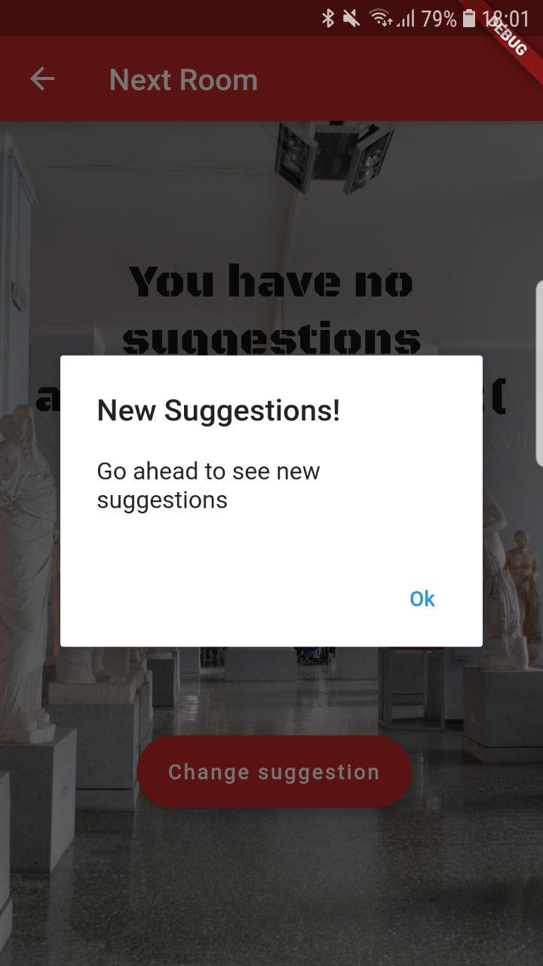
Our solution for personalized tours
Mobile application available for both iOS and Android
During a tour suggests the next section you could visit based on the time you have spent in the previous sections
The application will display a preview of the suggested section
The user could choose to follow it or to jump to another suggestion.
The suggestions are sent every time a user is leaving a section

Slide 5
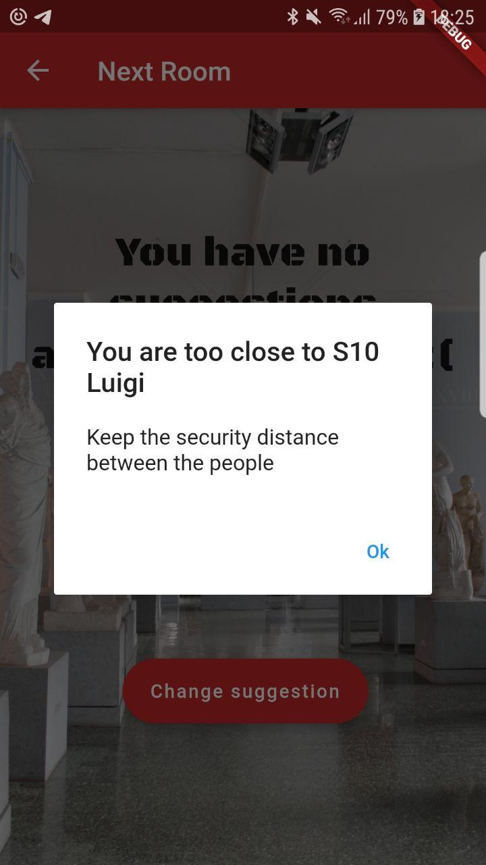
Our solution to avoid gatherings
Solve the crowd problem of our personalized tour in these times in which sections cannot be overcrowded:
Added features to try to equalize the number of people in each section.
Suggest the most interesting section for the visitor and, at the same time, try to avoid the formation of gatherings
Estimating the proximity of two different visitor and check if they are respecting the security distance.

Slide 6
Changes from 2 delivery
The main changes from the second delivery are:
We faced the problem of the COVID-19 and limited accesses to the museum in our system and redefined our solution taking into account this factor.
After some tests we decided to discard the option to implement the communication between each board and Azure IoT Hub using LoRaWAN. The test we have done to make this decision will be later described.

Slide 7
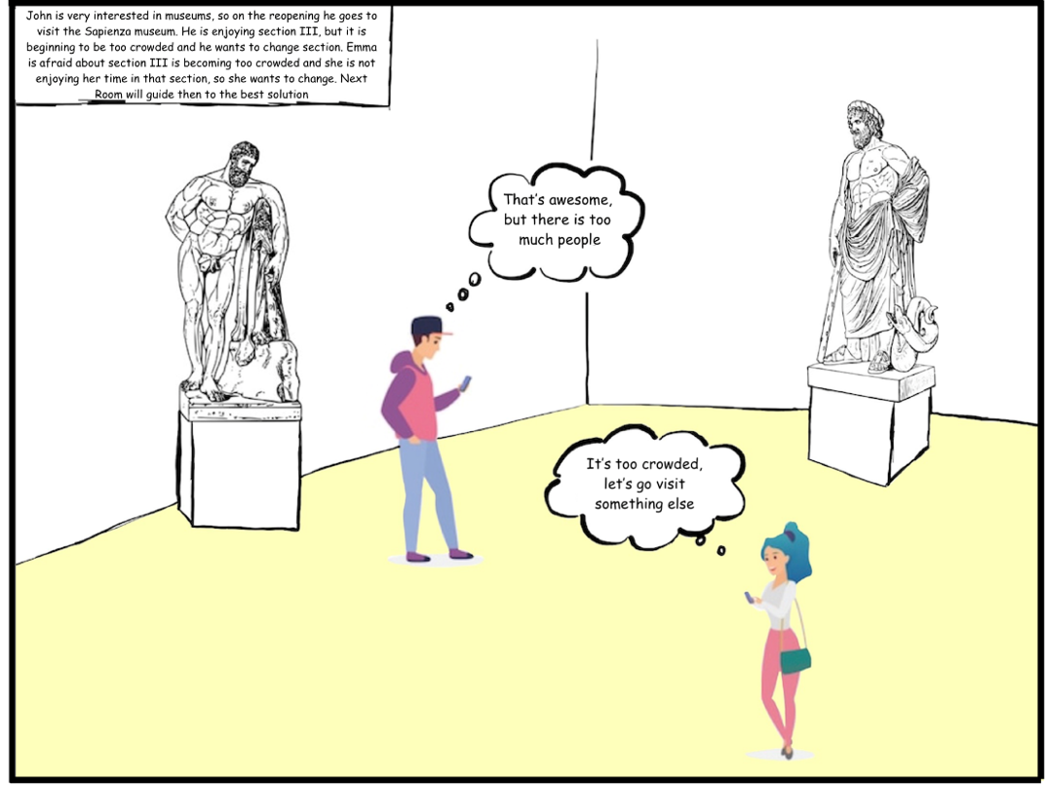
A Possible Scenario

Slide 8
A Possible Scenario

Slide 9
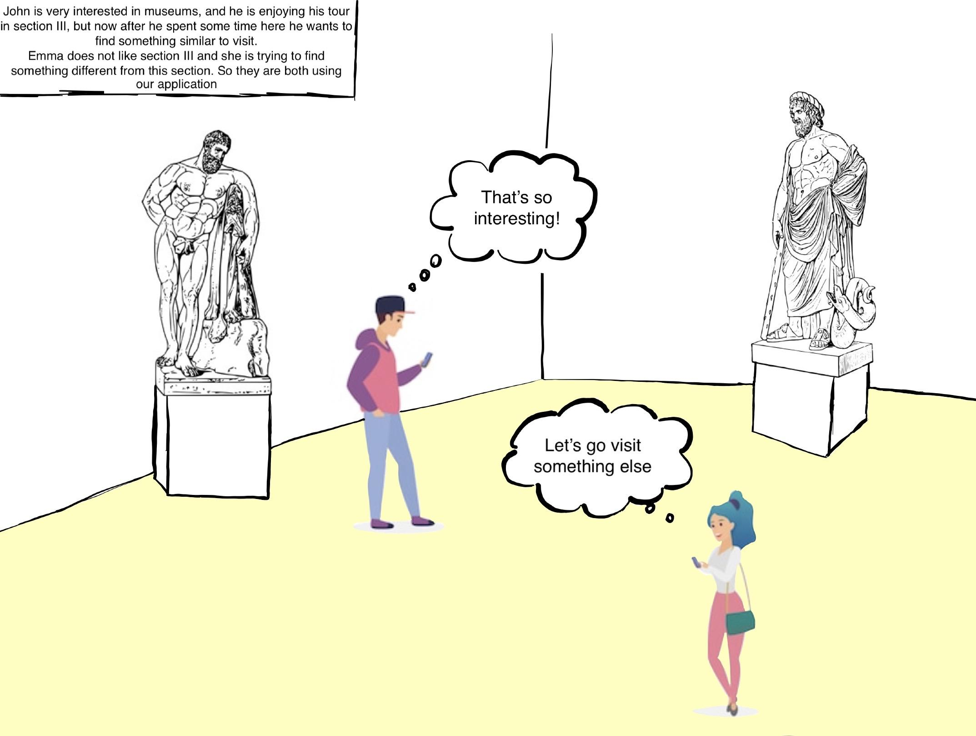
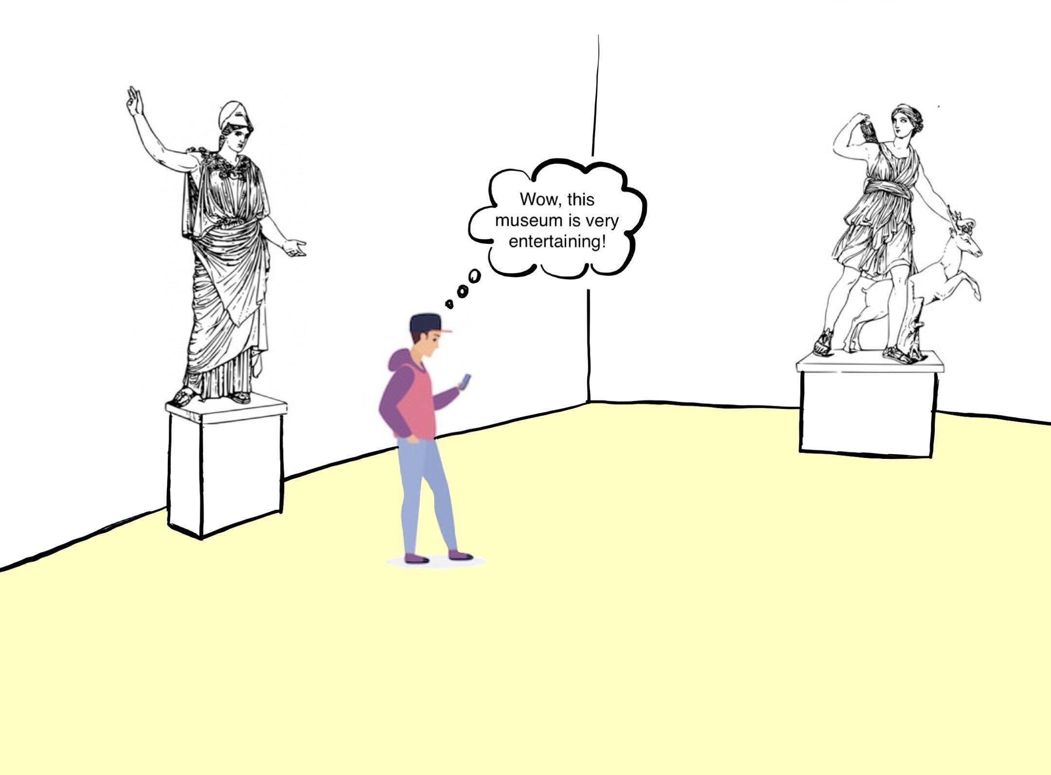
A Possible Scenario

Slide 10
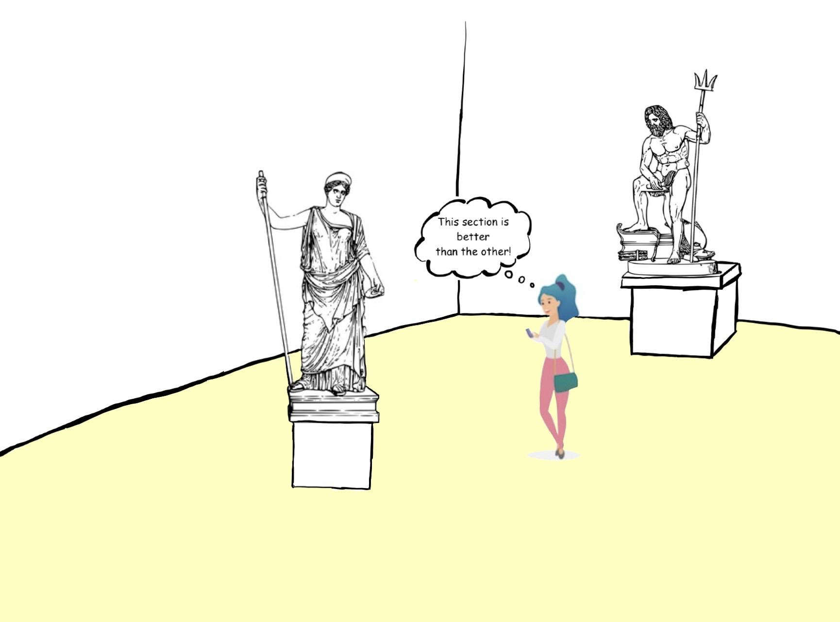
A Possible Scenario

Slide 11
Hardware Components

Slide 12
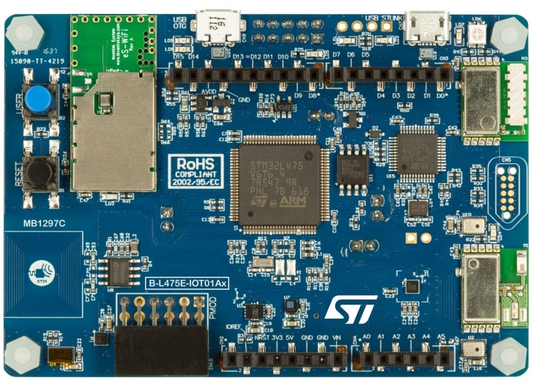

B-L475E-IOT01A Discovery kit
Ultra-low-power STM32L4 Series MCUs based on Arm® Cortex®-M4 core with 1 Mbyte of Flash memory and 128 Kbytes of SRAM
Bluetooth® V4.1 module (BLE technology)
802.11 b/g/n compliant Wi-Fi® module from Inventek

Slide 13
Software Services

Slide 14

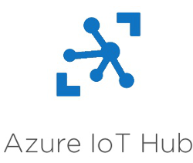
IoT components
Eclipse Mosquitto as MQTT broker
Azure IoT Hub

Slide 15


Cloud components
Azure Function to calculate the suggestion
Azure SQL DB to store the data

Slide 16


Programming languages used
c++ to write the code for the IoT board using Mbed OS
Python for the suggestion algorithm and the data persistence
Dart to write the code for the mobile application using Flutter

Slide 17
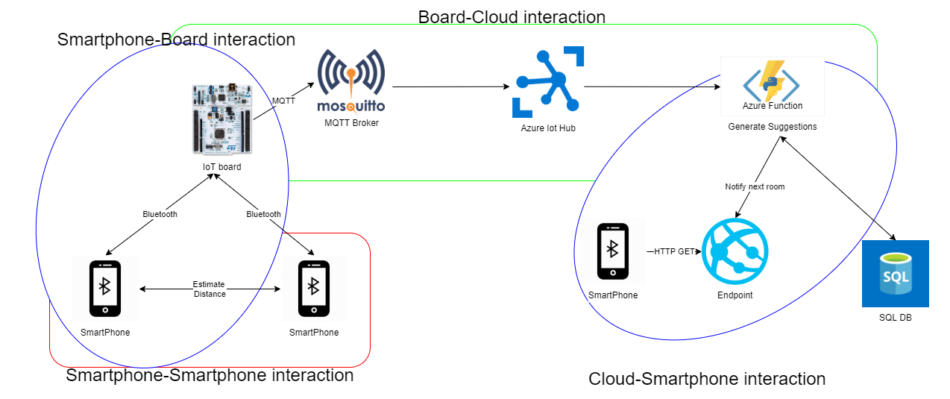
Network diagram

Slide 18
Technical work
We have implemented the cloud infrastructure to make the system work:
An SQL database with all the necessary tables to maintain useful data to be processed by our system.
We implemented a scoring algorithm that takes into account the similarity between recent visits and the current visit, and the number of people that is currently in each section.
We have a starting version of the web application that gives suggestion about the next room to visit,
taking into account the taste of the visitor and the crowding situation in each section.

Slide 19
Evaluation

Slide 20
UX evaluation
We could not evaluate it giving a try in a museum to a user and asking him or her for feedback
We evaluated our application and in particular, the user interface and its interactivity, giving people the application or videos of the application running on a smartphone.
One feedback that we have collected was to create multiple suggestions and to let the user choose the suggestion he or she likes the most. This is a fix that we have already implemented, as we said above.
The other main feedback that emerged from this kind of evaluation is that it could be cool if the application presents a map of the museum with the spot in which the user is, and the room he or she is suggested to visit. We did not yet implement this feature, although we believe this is a great idea. This feature will certainly be part of our future works.

Slide 21
Technical Evaluation
We have done a technical evaluation performing load tests on all parts of our system:
BLE IoT device-Smartphone interaction: how many smartphones a single device can handle?
We conducted a simulation using the same device to connect to the board within a short period of time before it sends the list of devices to the cloud and empties the list. The results that we obtained were pretty good because the board could send an MQTT message with an average of 14 session IDs with the current parameters. But we found out that this is the bottleneck of our system.
Cloud IoT device-Cloud interaction: what is the message rate with which the device can send messages to Azure IoT hub?
We have performed a simulation, through a Python script, sending data to the cloud and analyzing the behaviour of our algorithm. We discovered that saving data to the DB, is an important bottleneck, so we have decided to collect the data from the board at least every 30 seconds after the previous data collection.

Slide 22
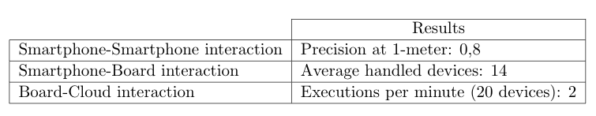
Technical Evaluation
We have tested the feature that aims to calculate the distance between two visitor, as we expected is not too precise. This is since every vendor use different Bluetooth sensor on their smartphone, so the RSSI at one meter that is used to estimate the distance is not a unique value.
We decided to introduce a threshold, if we detect that two people are too near to each other for more than three times we would notice to them.
Over 50 different measurements now 40 are correctly classified

Slide 23
Pricing Evaluation
Board Pricing
The board used is the B-L475E-IOT01A Discovery kit that has a retail price of about 50€
Considering at least two rooms per section, the estimated cost will be around 500€
Cloud Pricing
Azure Function: the first 400,000 GB/s of execution and 1,000,000 executions are free. Then you pay what you consume (serverless)
App service: The basic plan cost around 60€, for testing purpose we will use the free one.
Azure SQL Database: We choose to use the serverless option also in the DB, we use the maximum size of 15GB but it is possible to use more space.

Slide 24
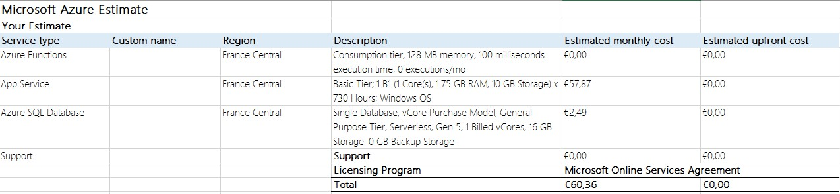
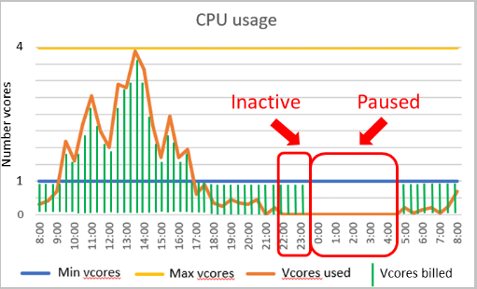
Pricing Evaluation

Slide 25
Future developments
Improve the user experience of our application adding a map that shows the users current position and the position of the section/room suggested by the system
Implement a Curators Dashboard to monitor the amount of people in each section and to better handle the people flow in the museum
Improve the accuracy of the estimated distance via Bluetooth adding other parameters than the RSSI

Slide 26
To be done

Slide 27
User Experience Evaluation
We are planning evaluate the user experience using mockups, and after every demo of these prototypes we will collect people's opinions asking for feedbacks and publishing some google forms.
The questions will be mainly on:
User interface
Application services

Slide 28
Thank you for listening

